Slide 1
Module 3
Designing Web Pages Elements using Cascading Style Sheets (CSS)

Slide 2
Content
Introduction to CSS
How to work with Style Definitions
How to work with Style Inheritance
How to work with Box Model
How to work with Fonts
How to Style a web page using CSS

Slide 3
Overview of CSS
Overview of CSS Syntax How CSS Selectors Work How HTML Inheritance and Cascading Styles Affect Styling Adding Styles to An HTML Page
Notes:
As with lesson 1, much of the material in this lesson should be review. However, students are likely to be less familiar with CSS than with HTML, so you may need to spend a little time to ensure that students understand the principles of styling and how CSS works. In particular, emphasize the importance of understanding cascading and inheritance in style sheets.
20480C
1: Overview of HTML and CSS

Slide 4
Overview of CSS Syntax
All CSS rules have the same syntax:
Comments are enclosed in /* … */ delimiters
selector {
property1:value;
property2:value;
..
propertyN:value;
}
/* Targets level 1 headings */
h1 {
font-size: 42px;
color: pink;
font-family: 'Segoe UI';
}
Notes:
Make sure that students understand the basic CSS selector/rule syntax. Be prepared to give them further examples if necessary.
20480C
1: Overview of HTML and CSS

Slide 5
How CSS Selectors Work
There are three basic CSS selectors
The element selector: h2{}
The class selector: .myClass {}
The id selector: #thisId {}
CSS selectors can be combined to create more specific rules
The wildcard * selector returns the set of all elements
Use […] to refine selectors based on attribute values
Notes:
Be prepared to take extra time over this topic. The syntax of concatenated selectors and attribute selectors can be confusing at first, so be prepared to give further examples.
20480C
1: Overview of HTML and CSS

Slide 6
How HTML Inheritance and Cascading Styles Affect Styling
HTML inheritance and the CSS cascade mechanism govern how browsers apply style rules
HTML inheritance determines which style properties an element inherits from its parent
The cascade mechanism determines how style properties are applied when conflicting rules apply to the same element
Notes:
Make sure that students understand that the same HTML element can be the target of multiple CSS selectors. The cascade mechanism determines how the rules associated with these selectors are applied.
20480C
1: Overview of HTML and CSS

Slide 7
Adding Styles to An HTML Page
Use an element's style attribute to define styles specific to that element:
Use the <style> element in the <head> to include styles specific to a page:
Use the <link> element to reference an external style sheet:
<p style="color:blue;"> some text </p>
<style type="text/css">
p { color: blue; }
</style>
<link rel="stylesheet" href="mystyles.css" >
Notes:
This course places styles in a set of separate style sheets. The HTML pages in the lab application use <link> elements to reference the style sheets.
20480C
1: Overview of HTML and CSS

Slide 8
Writing CSS
Defining Styles
External Style Sheets
Inline Style Sheets
Declaration Block
Selectors
Browser-specific Prefixes
Adding Comments to a CSS

Slide 9
Basic Selectors
Understanding Selectors
Working of Selectors

Slide 10
Rule Sets
CSS Rule Sets are statements
that allow you to
select multiple HTML elements based
on a pattern
and apply a list of declarations
that format those
Elements

Slide 11
Rule Set Terminology
A rule set consists of a selector and a declaration block

Slide 12
Rule Set Terminology…continued
The declaration- consists of one or more property (is the CSS element being
manipulated) value (represents the value of the specified property) pairs

Slide 13
Property & Value:
Each individual declaration consists of a pairing of a:
Property: the HTML property being modified
Value: the new value of the HTML property.

Slide 14
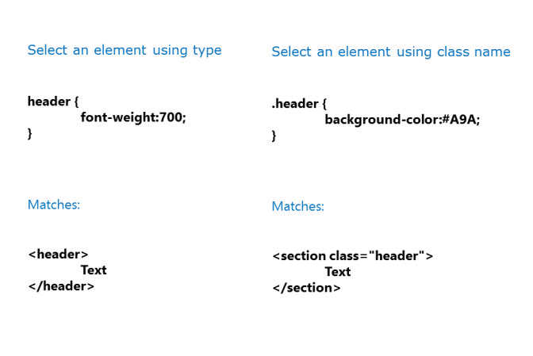
Selectors

Slide 15
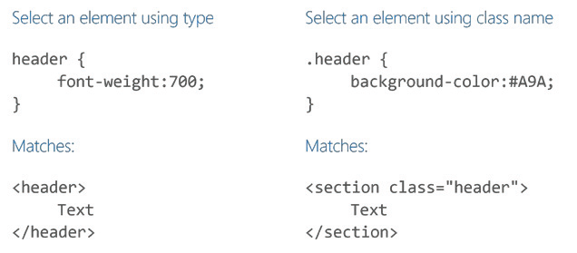
Selecting using Class name

Slide 16
Selecting using Id or descendant element

Slide 17
Multiple elements and selecting immediate siblings

Slide 18
Direct descendant elements

Slide 20
Types of Selectors
Universal Selectors
Type Selectors
Class Selectors
ID Selectors
Descendant Selectors

Slide 21
Styling Text
Working with Fonts
font-family
font-size
font-style
font-variant
font-weight
Dealing with Line Spacing
Changing the Text Color

Slide 22
Text Formatting
text-align
text-decoration
text-indent
text-transform
vertical-align
white-space
text-overflow

Slide 23
Text shadow
Text Shadow
Adding Blur Effect to Shadow
White Text with Black Shadow
Adding Multiple Shadows

Slide 24
Working with Layouts
Introduction to CSS Box Model
Setting Element Dimensions
Setting Box Size
Height and Width
Paddings and Margins
Specifying Paddings
Specifying Margins
Removing Default Margins
Changing Layout with display
Controlling Visibility

Slide 25
Box model
Margin
The margin property in CSS defines the space between an HTML element and the surrounding element.
It defines a shorthand property for setting the margin properties in one declaration.
Border
Each element has a border whether it is transparent or has a width of 0 pixels. You can change the border to have a width, style and color of your specification.

Slide 26
Margin in Box model

Slide 27
CSS box model

Slide 28
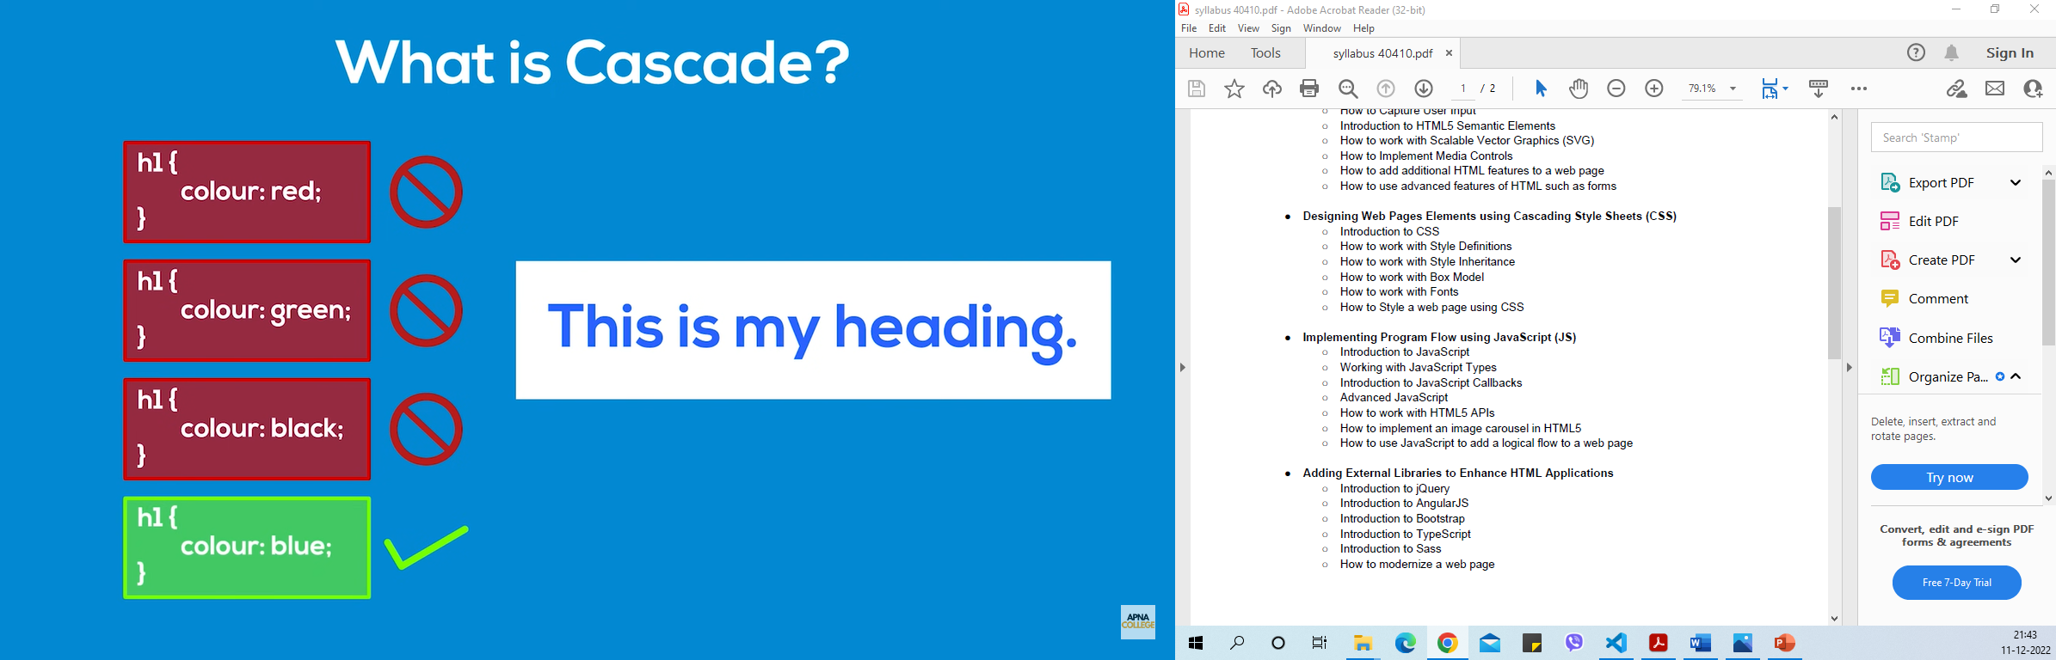

Slide 29
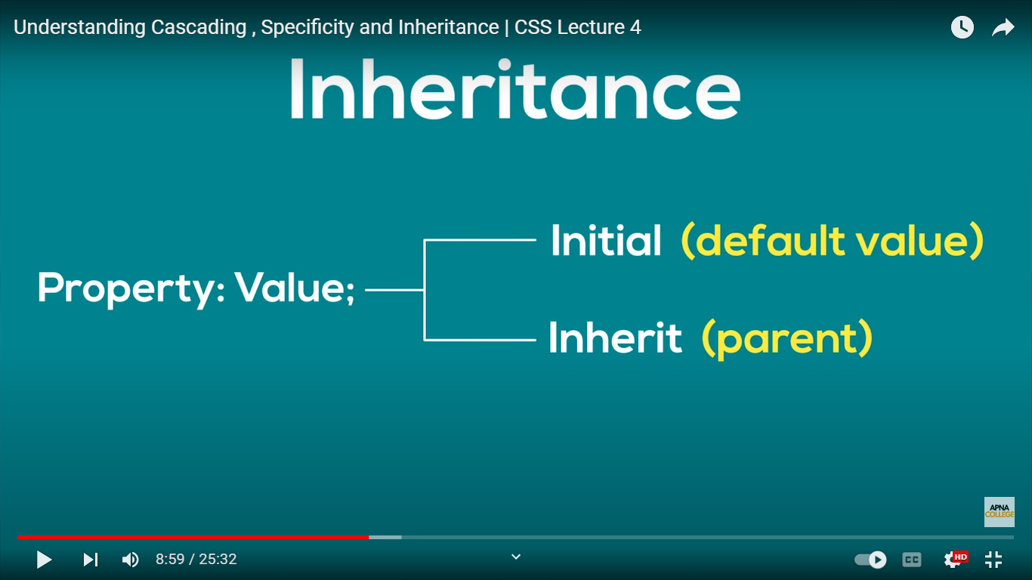

Slide 30
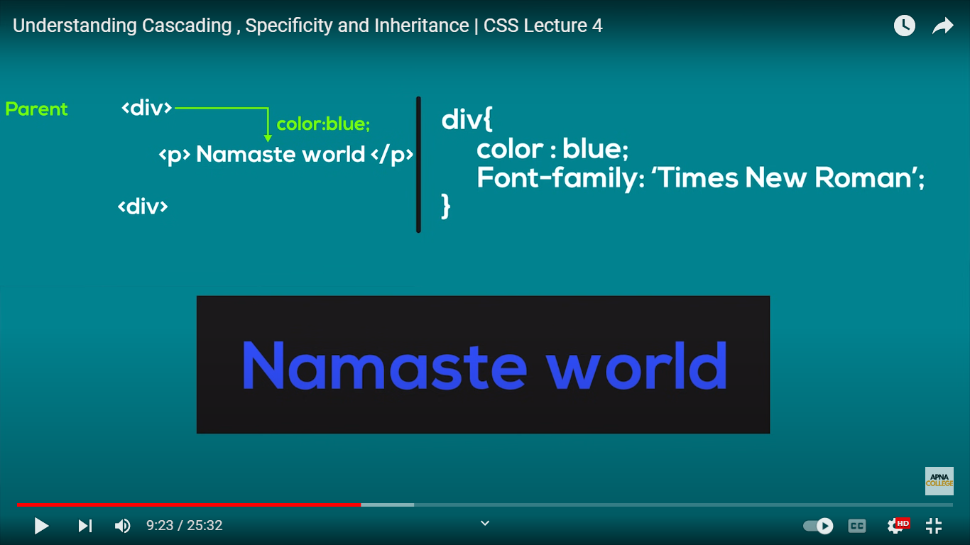
Child p inherits property of it’s parent div

Slide 31
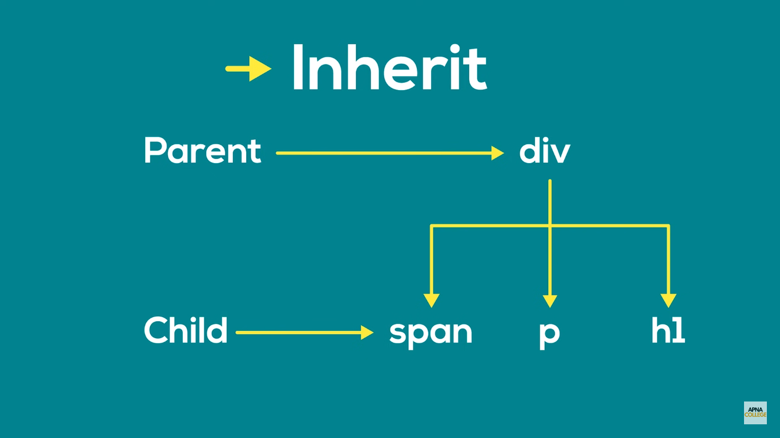

Slide 32
Background
CSS Background
background-color
background-image
background-repeat
background-position
background-attachment
Adding Multiple Images to the Background

Slide 33
Borders
Defining Borders
Border-style
Border Width
Border Color
Border Shorthand
Rounded Corner Borders

Slide 34
Shadows
Adding Drop Shadows
Adding Drop Shadow
Using Inset
Outline Styling

Slide 35
Lists and Navigation Menus
Working with Lists
List Styling Properties
Navigation Menus
Creating Vertical Navigation Bars
Creating Horizontal Navigation Bars

Slide 36
Styling Tables
Table Structure
Table Border
Table Headings
Cell Padding
Adding Caption to a Table
Defining Styles for tables
Column Groups
Styling Tables in CSS

